Slide 1
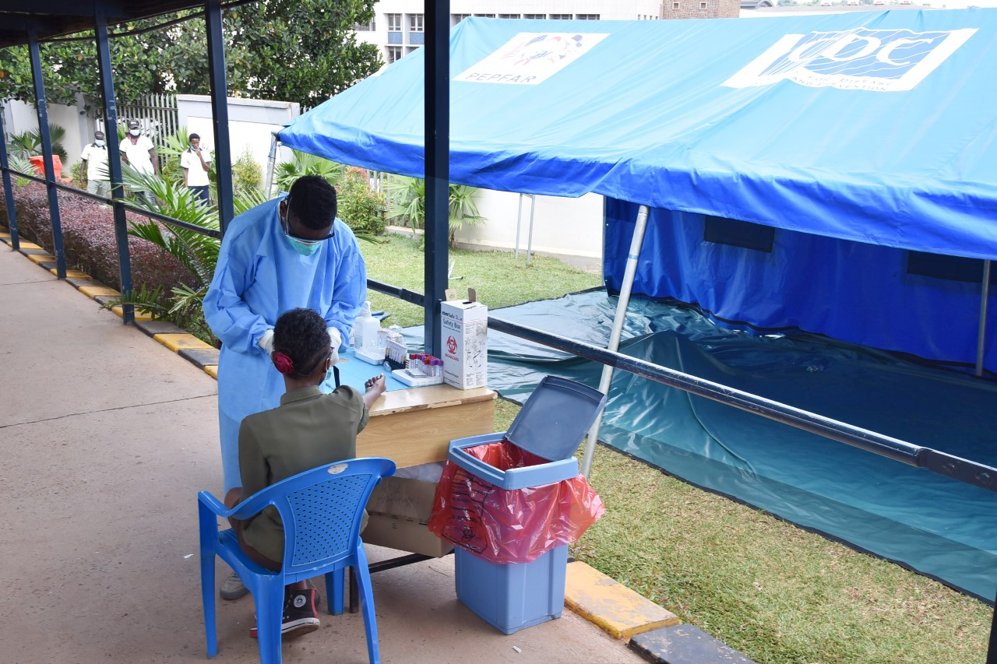
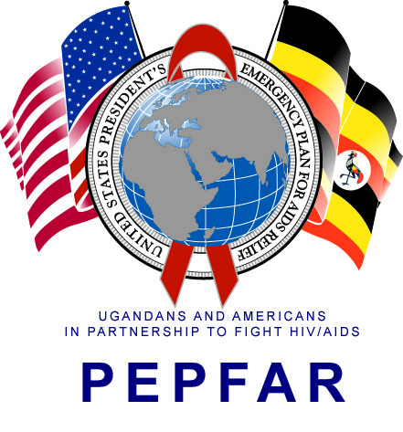
VIROLOGIC OUTCOMES AMONG PATIENTS ON FIRST-LINE ANTIRETROVIRAL THERAPY (ART) FOLLOWING TRANSITION TO DOLUTEGRAVIR AT A TERTIARY HIV CLINIC IN UGANDA
Abdullah Wailagala, Eva Laker, Maria Sarah Nabaggala, Letisha Najjemba, Alex Onyege, Ruth Mirembe Nabisere, Martha Atwiine, Angelo Mugume, Arinaitwe Arnold, Nelson Kalema, Agnes Kiraggga, Ahmed Ddungu, Noela Clara Owarwo, Mohammed Lamorde, Barbara Castelnuovo
BACKGROUND
In 2018, Uganda adopted dolutegravir (DTG) in place of non-nucleoside reverse - transcriptase inhibitors (NNRTIs) for first line ART regimens.
As a pilot site, the Infectious Diseases Institute clinic at Makerere University College of Health Sciences started transitioning PLHIV on NNRTIs to DTG and initiating the ART naïve to DTG by mid 2017.
Viral load (VL) suppression (<75 copies/ml) was required before transition as per the clinic guidelines.
STUDY AIM
To assess the virologic outcomes among PLHIV on 1st line ART by ART status following this transition.
METHODS
Retrospective electronic chart review between Jan.2018 - Oct. 2019.
Descriptive statistics used to compare VL in PLHIV maintained on NNRTI with those initiated on DTG and those transitioned to DTG.
Multivariable logistic regression used to determine factors associated with detectable VLs (≥75copies/ml).
RESULTS
VL results were available for 6,623 /6971 (95.0%) patients.
The odds of a detectable viral load between the three groups (Table 2).
Table 2: Multivariate analysis of factors associated with a detectable VL
Variable | Unadjusted Odds ratio (95% CI) | P-value | Adjusted Odds ratio (95% CI) | P-value
Sex
Females | 1.00 | . | 1.00 | .
Males | 1.46 (1.16,1.84) | 0.001 | 1.72 (1.32, 2.25) | 0.000
Age group in years
15-35 | 1.00 | . | 1.00 | .
35-45 | 0.83 (0.62, 1.11) | 0.211 | 0.87 (0.64, 1.18) | 0.375
46-54 | 0.73 (0.53, 1.00) | 0.052 | 0.82 (0.58, 1.17) | 0.273
55 and above | 0.68 (0.46, 0.99) | 0.045 | 0.77 (0.51, 1.89) | 0.239
Duration on ART
0 – 5 years | 1.00 | . | 1.00 | .
6 – 10 years | 0.78 (0.59, 1.02) | 0.068 | 0.89 (0.67, 1.19) | 0.443
Above 10 years | 0.59 (0.44, 0.82) | 0.001 | 0.73 (0.51, 1.03) | 0.073
ART Status
Still on NNRTI | 1.00 | . | 1.00 | .
Had transitioned to DTG | 2.01 (1.19, 3.41) | 0.009 | 1.34 (0.75, 2.38) | 0.319
Initiated on DTG regimen | 0.86 (0.68, 1.09) | 0.216 | 0.73 (0.56, 0.97) | 0.028
Table 1: Patient Demographics
Characteristic | n=6791 (%)
GENDER
Female | 4358 (62.5)
Male | 2613 (37.5)
AGE GROUP
15-35 | 1666 (23.9)
35-45 | 2281 (32.7)
46-54 | 1949 (28.0)
>= 55 | 1075 (15.4)
DUARTION ON ART IN YEARS
0-5 years | 1918 (27.5)
6-10 years | 2851 (40.9)
Above 10years | 2202 (31.6)
DTG STATUS
Still on NNRTIs | 3216 (46.1)
Switched from NNRTIs to DGT | 3447 (49.6)
ART naïve initiated on DTG | 308 (4.4)
Figure 1: Virologic outcomes by ART status
CONCLUSION
PLHIV initiated or transitioned to DTG based 1st line ART had a similar virological suppression with those still on NNRTI based 1st line ART.
RECOMMENDATION:
Our findings support the Uganda and WHO recommendation to transition from NNRTI to DTG based 1st line ART.
Acknowledgement:
This program has been supported by the President’s Emergency Plan for AIDS Relief (PEPFAR) through CDC under the terms of CoAg Number: GH002022
POSTER NUMBER: PEB0112
PRESENTED AT THE 23RD INTERNATIONAL AIDS CONFERENCE (AIDS 2020) | 6-10 JULY 2020

